Slide 1

Tutorial Questions （Week 11）
Juntao Zhang(张峻滔), TA
Southern University of Science and Technology
Email: 12332164@mail.sustech.edu.cn

Slide 2
Outline
Review
Tutorial Problems 7.25 7.37 7.40
Q&A

Slide 3
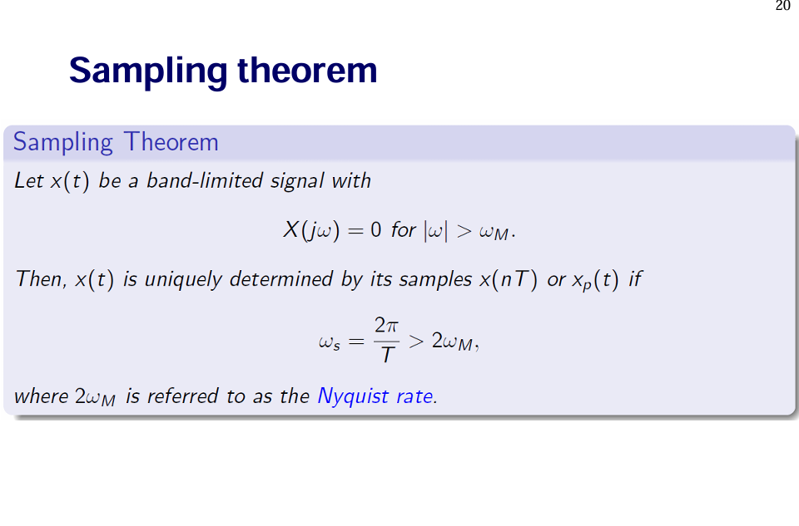

Slide 4
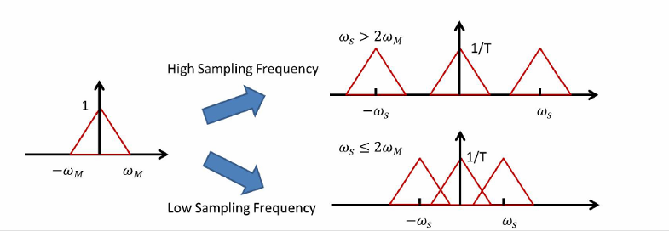
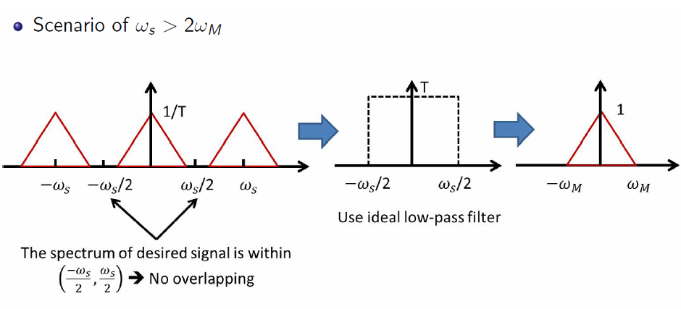
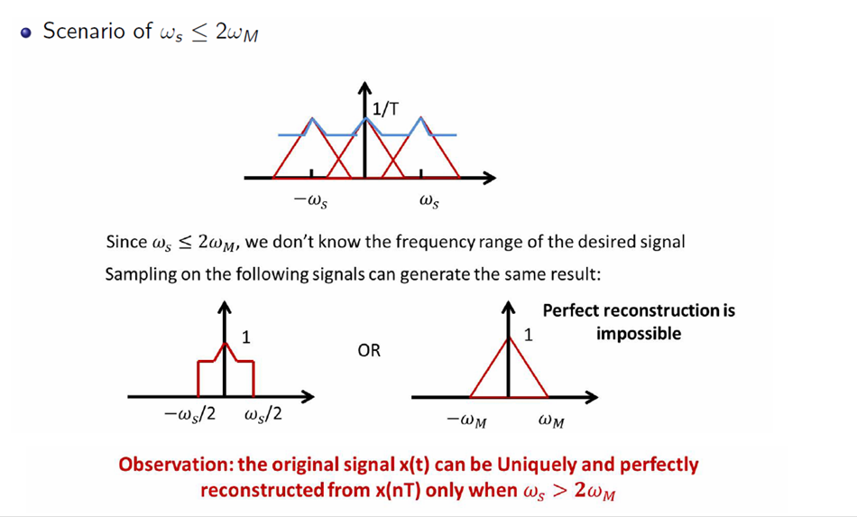

Slide 5
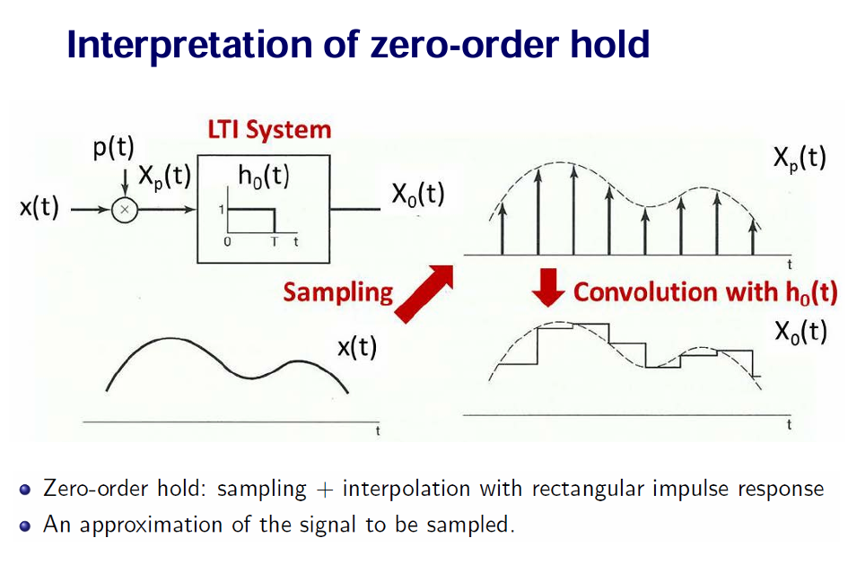

Slide 6
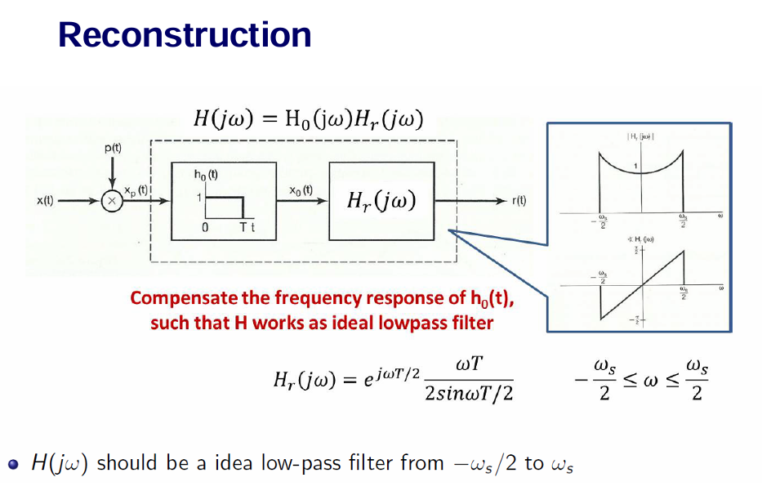
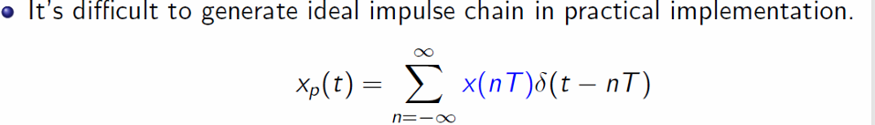
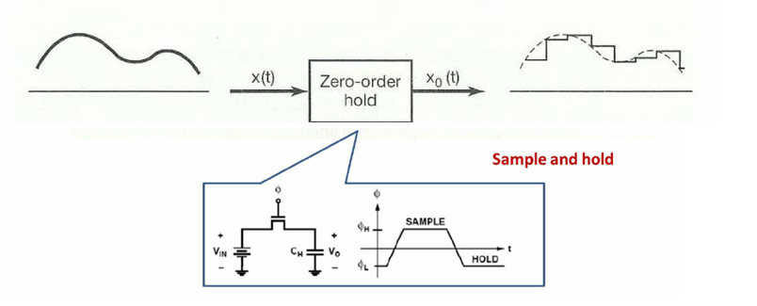
Combine p(t) and h₀(t) as a system

Slide 7
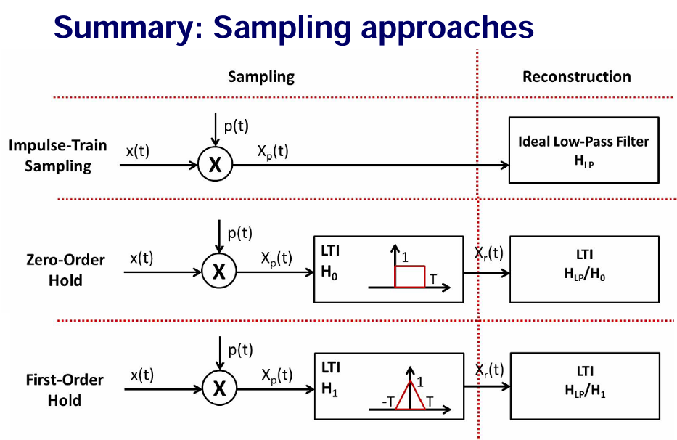

Slide 8
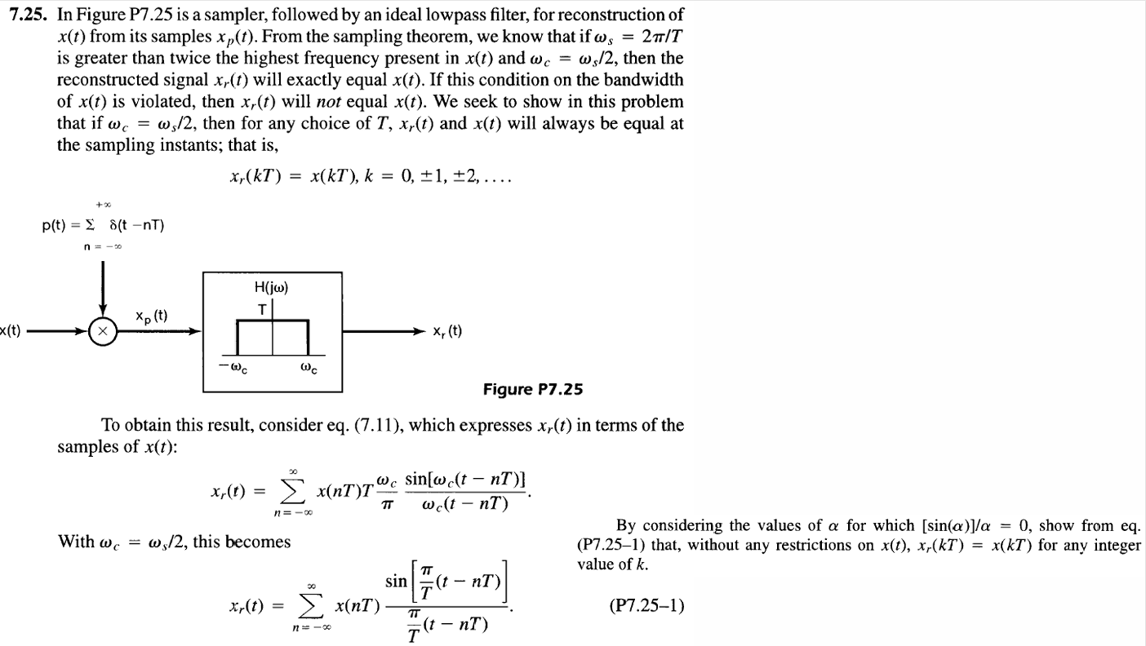


Slide 9
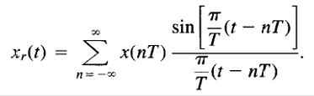
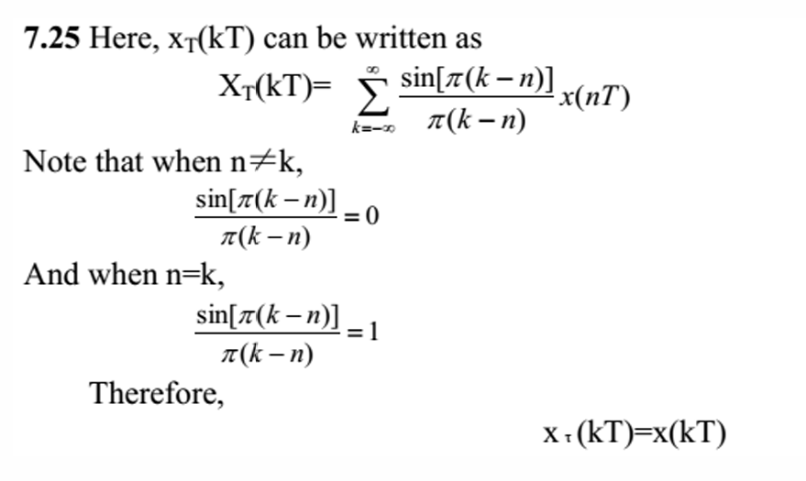

Slide 10
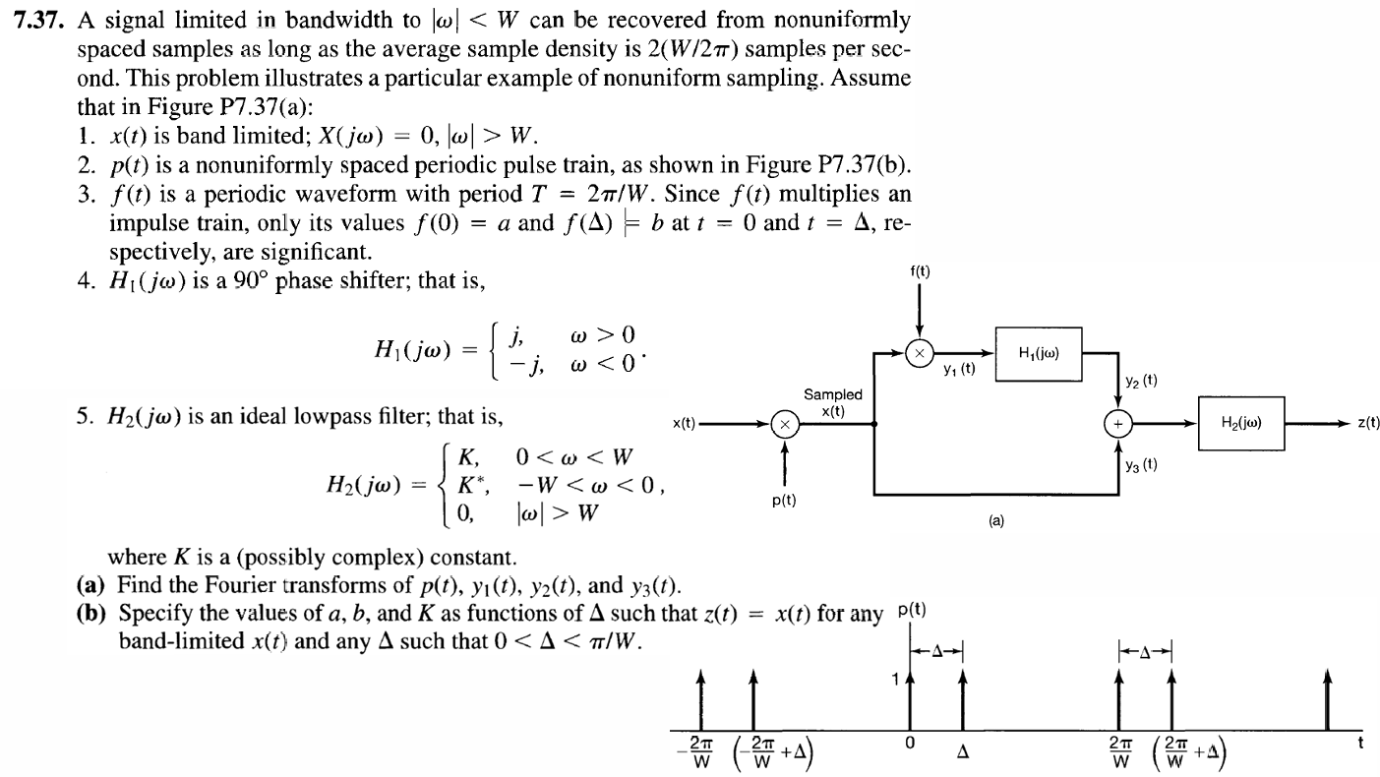

Slide 11
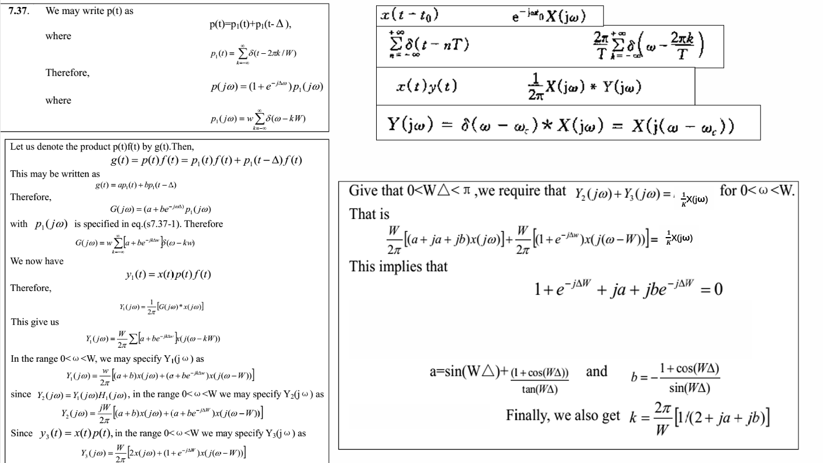

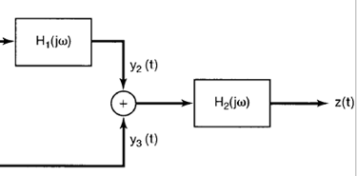





2

Slide 12
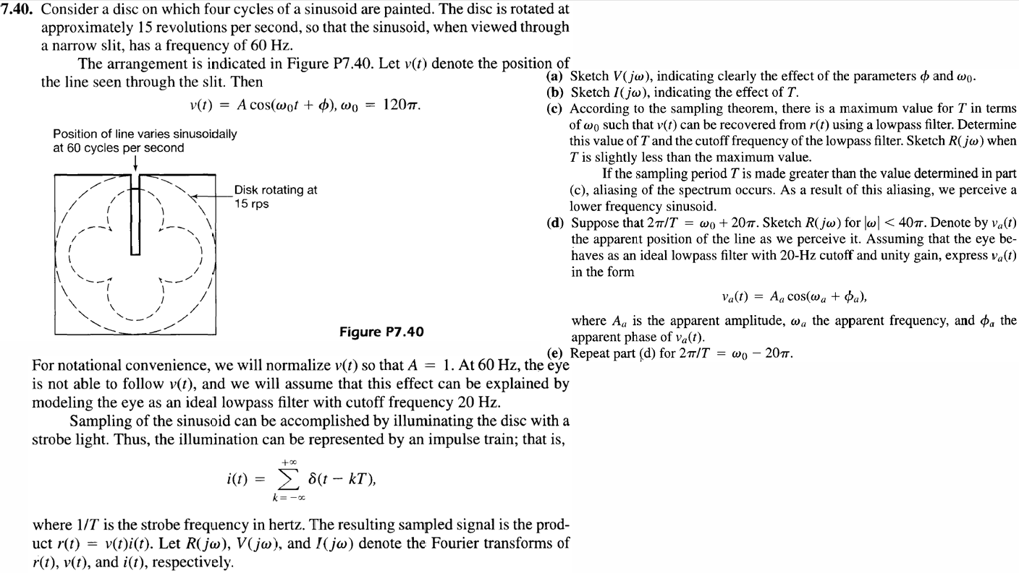

Slide 13
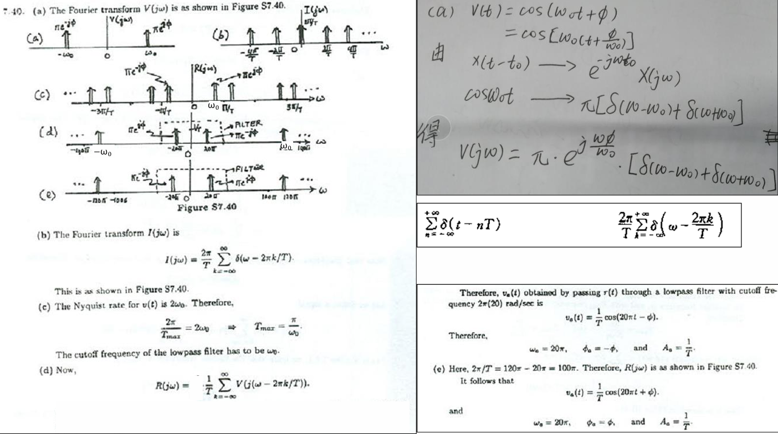

Slide 14
Thanks for Your Attendance
Q&A
Juntao Zhang(张峻滔), TA
Southern University of Science and Technology
Email: 12332164@mail.sustech.edu.cn

